Slide 1
BIE Alternate Science Assessment
Administrator Training

Slide 2
Welcome and Purpose
Welcome from the Chief Academic Office and Alternate Science Assessment Team!
Dr. Tamarah Pfeiffer, Aurelia Shorty, Dr. Rebecca Izzo, Niccole White, Dr. Maureen Lesky
Provide administrator training for BIE’s Alternate Science Assessments for Spring 2021
Provide a set of expectations for the administration of the Alternate Science Assessment

Slide 3
What is the BIE Alternate Science Assessment?
The BIE Alternate Science Assessment is a standards-based assessment designed specifically for students with the most significant cognitive disabilities.
The BIE Alternate Science is meant to provide a picture of student performance to schools, districts, educators, parents, and the community.
The BIE Alternate Science assesses a student’s performance in Science.
Students who take the BIE Alternate Science participate in BIE testing just as their peers without disabilities

Slide 4
Who are the Students?
Students with the most significant cognitive disabilities…
Receive instruction on the BIEs modified next gen. science standards.
Requires extensive, repeated, and individualized instruction
Uses substantially adapted and/or modified materials
Not Individuals with Disabilities Education Act (IDEA)category specific
CANNOT have a Specific Learning Disability (SLD)
Generally – Intellectual disability(ID), Muscular Dystrophy(MD), Autism, D/B
Not all students with Intellectual disability(ID) should qualify
BIE Alternate Science Assessment intended for students 3 Standard Deviations(SD)below mean, higher than 55

Slide 5
Who can give the BIE Alternate Science ?
Certified teacher
Full/part time classroom teacher
Related services provider (Speech-language Pathologist(SLP), Occupational therapist (OT), etc.)
Participate in training every year
Para-educators cannot administer the BIE Alternate Science
May be in room as a behavioral/medical/translation support
Test Administrators must not administer the test to relatives nor be in the same testing environment as their relatives during testing

Slide 6
Security Standards

Slide 7
BIE Alternate Science Security Standards
Tests must NOT be:
Stored or saved on computers or personal storage devices
Shared via email or another file sharing service
Reproduced by any means
Electronic materials used during the assessment administration may not be printed.
Users will not give out, loan, or share their password with anyone. Allowing others access to an PearsonAccess Next account may cause unauthorized access to private information.

Slide 8
Chain of Custody
A documented chain of custody must be kept
Test materials must be secure at all times
With the School Test Coordinator before and after testing session
With the Test Examiner during testing session
Access before testing may be needed to create accommodations
Notes:
- Secure storage: BIE Alternate Science Test Examiners must account for and return test materials and individualized accommodations to the SAC for storage in a secure and locked location immediately after administration, at least on a daily basis. Test materials must not be stored in classrooms.
SAC distributes materials to Test Examiners: The SAC is responsible for the distribution of test materials to BIE Alternate Science Test Examiners and for the collection of the test materials during the preparations or accommodations as well as on each day of testing. SACs will have Test Examiners sign the BIE Alternate Science materials out and back in once returned. Only materials for the student being assessed at that time should be distributed to the Test Examiner.
-Due to the unique nature of the BIE Alt: Science and Social Studies assessments, Test Examiners may need access to a student’s materials prior to the test’s administration in order to prepare any necessary accommodations and organize the provided student materials and manipulatives.

Slide 9
BIE Alternate Science

Slide 10
BIE Alternate Science
Paper-based assessment for Grades: 5, 8, & 11
Individually administered
Scored locally by the Test Examiner
Scores are entered into the PearsonAccess Next portal
Test Examiners enter scores into Pearson Access Next
Score entry window closes the Friday after the test window closes
Score entry window closes on June 4th
Test books are oriented to the Test Examiner and the student face each other
Two item types
Selected Response
Supported Performance Tasks

Slide 11
BIE Alternate Science
Student is presented with three or four answer options
BIE Alternate Science Test Examiners may not rephrase the prompt
Repeat the prompt at level four only when the student does not respond the first time
An additional prompt is included at level three to help engage the student
Student will work with the item until the correct answer is received or the maximum number of attempts is reached
Only one data point/score is recorded

Slide 12
BIE Alternate Science Preparing Materials for Assessment
Read through Test Manual
Preparation of Accommodations/Task Manipulatives
Read through Items
Cut out task manipulatives
Individual administration
(Only Test Examiner and Student in Testing Environment)
No time limits or restrictions on time
Allow time for breaks

Slide 13
Test Examiner Activities Before Testing
Write the school and student’s name on the test booklet
Write the student’s name on the secure return envelope
Cut apart the task manipulatives
Paper clip the task manipulatives to the corresponding page
Keep all materials for each student together
Administer practice items
Familiarizes student with the process
https://bie.mypearsonsupport.com/altScience/

Slide 14
BIE Alternate Science Materials
One Zip lock packet per student
BIE Alternate Science Test Booklet/Manual
Secure Return Envelope
Task Manipulatives Kit
Secure Return Form (Signed by Test Administrator)
Score Recording Form
Task Manipulatives
Student Response Form
Vision Impaired (VI) Script

Slide 15
Test Materials
Grade 5, 8, and 11 have one unique form
Task manipulatives are shrink-wrapped with each test book
Each student must be assessed with “their” book and manipulatives
Vision Impaired (VI) Script
These are secure materials and need to be return to Pearson in the Secure Return Envelope
Notes:
Each student MUST be assessed with the same book and corresponding manipulatives per subject. The task manipulatives are shrink-wrapped together with the test book. Its important to keep the test materials that were shrink-wrapped, together.

Slide 16
Task Manipulatives
BIE Alternate Science Test Examiners should use the picture symbols in the test materials provided, except:
The student needs to use objects rather than pictures.
The student needs pictures of real objects rather than drawings.
The student has a personal lexicon with a specific representation for the concept or words in the student answer choices.
In this case, all answer choices must be from the student’s personal lexicon.

Slide 17
Task Manipulatives
The student facing pages of test items may need to be adapted:
Size
Color
Contrast levels
Dimension
Assistive technology / AAC
Tactile / Objects

Slide 18
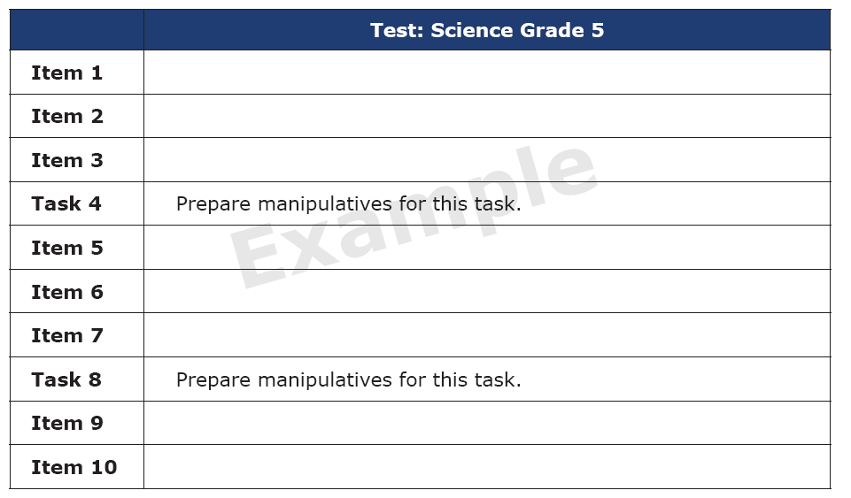
Test Layout
The beginning of each test shows the order of items and tasks.
Remember not all items have to be administered in one session.

Slide 19
Selected Response Items (SR)

Slide 20
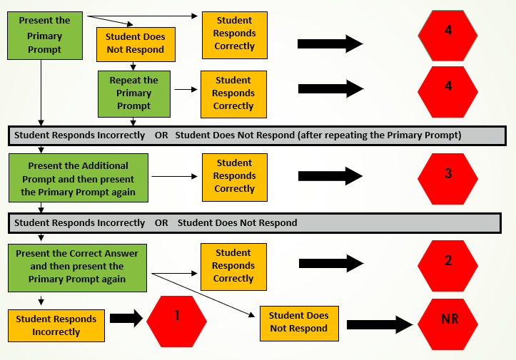
Selected Response Scoring

Slide 21
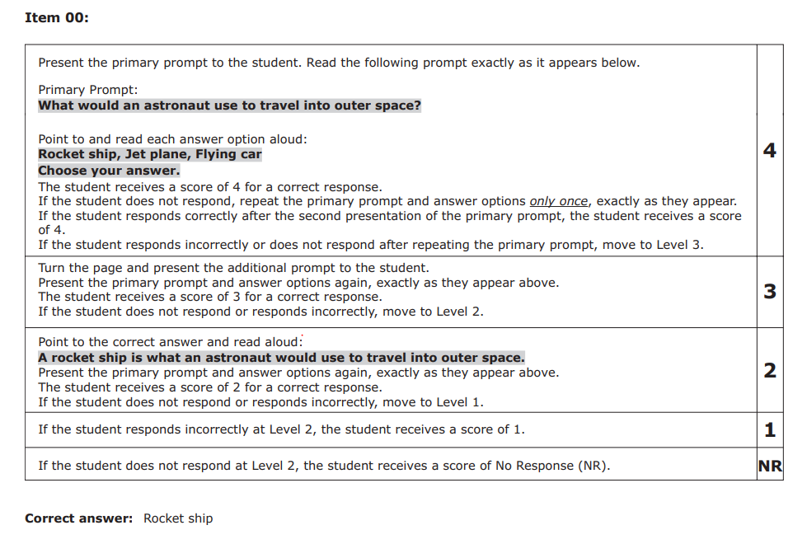
Selected Response Scoring
Teacher Facing Page

Slide 22
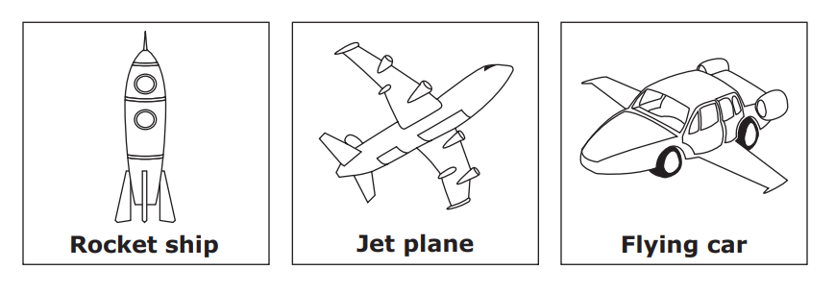
Selected Response Scoring
Student Facing Page

Slide 23
Selected Response Scoring
Student Facing Page

Slide 24
Selected Response Scoring
Does not respond?
Student Facing Page

Slide 25
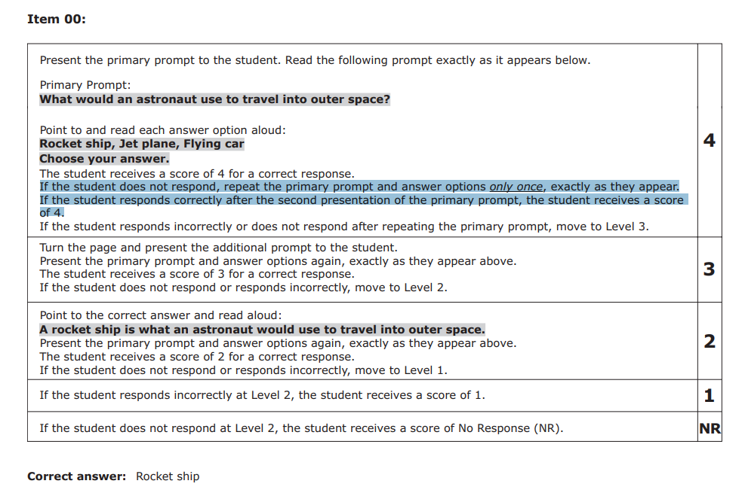
Selected Response Scoring
Teacher Facing Page
Notes:
Read the primary prompt one more time – exactly as written. Make sure that you point to the answer choices again.

Slide 26
Selected Response Scoring
Student Facing Page

Slide 27
Selected Response Scoring
Student Facing Page

Slide 28
Selected Response Scoring
Student Facing Page
Responds incorrectly?

Slide 29
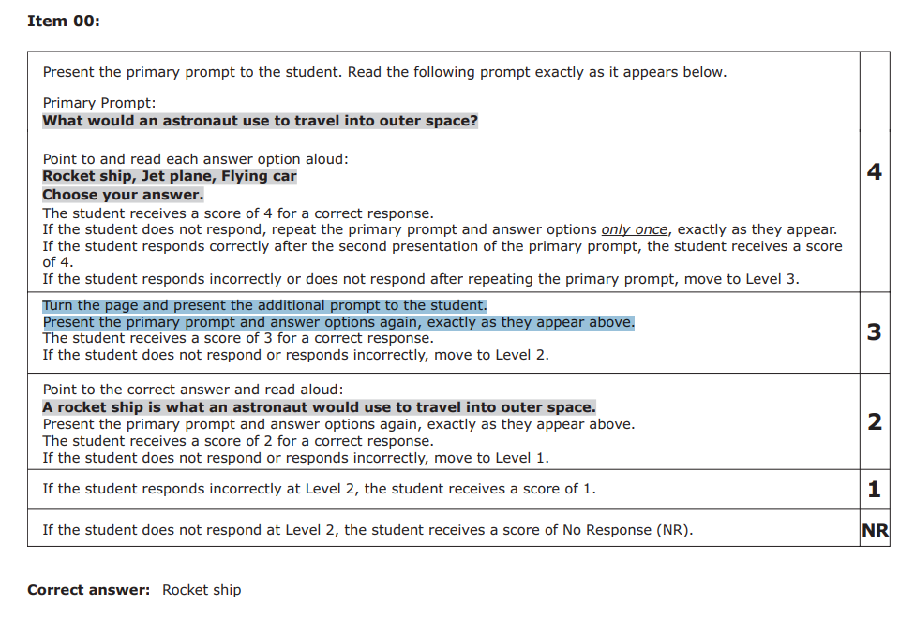
Selected Response Scoring
Teacher Facing Page
Notes:
If the student responds incorrectly or does not answer at all, you will turn the page and read an additional prompt

Slide 30
Selected Response Scoring
Teacher Facing Page
Notes:
If the student responds incorrectly or does not answer at all, you will turn the page and read an additional prompt

Slide 31
Selected Response Scoring
Student Facing Page
Notes:
If the student responds incorrectly or does not answer at all, you will turn the page and read an additional prompt

Slide 32
Selected Response Scoring
Student Facing Page

Slide 33
Selected Response Scoring
Student Facing Page

Slide 34
Selected Response Scoring
Does not respond or responds incorrectly?
Student Facing Page

Slide 35
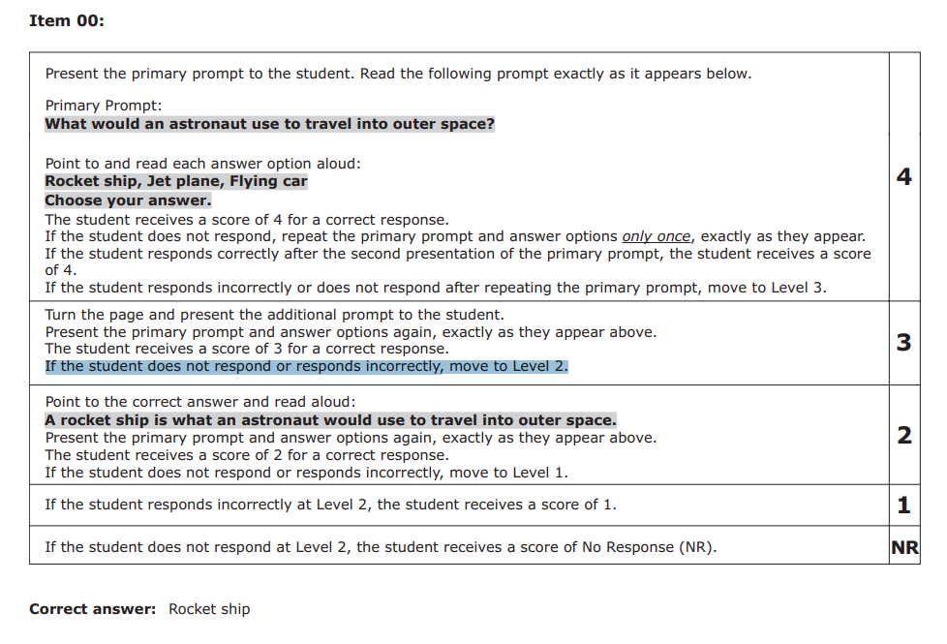
Selected Response Scoring
Teacher Facing Page

Slide 36
Selected Response Scoring
Student Facing Page

Slide 37
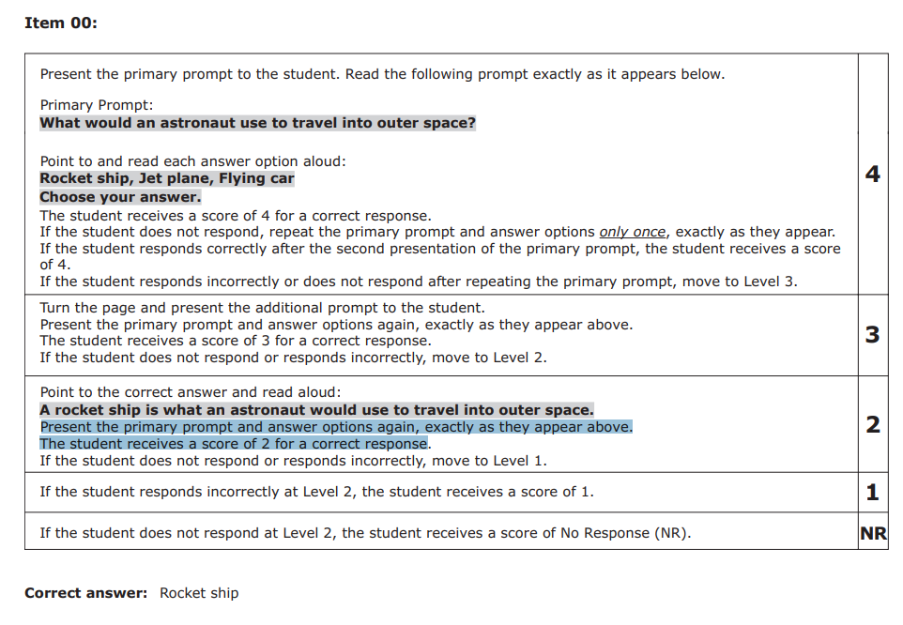
Selected Response Scoring
Teacher Facing Page

Slide 38
Selected Response Scoring
Student Facing Page

Slide 39
Selected Response Scoring
Student Facing Page

Slide 40
Selected Response Scoring
Responds incorrectly?
Student Facing Page

Slide 41
Selected Response Scoring
Student Facing Page
Does not respond?
NR

Slide 42
Supported Performance Tasks (SPT)

Slide 43
Supported Performance Task
Identified as Task # within the test book
Three prompts related to one task
Student manipulates option cards by placing them on the student response page (or indicates location for placement)

Slide 44
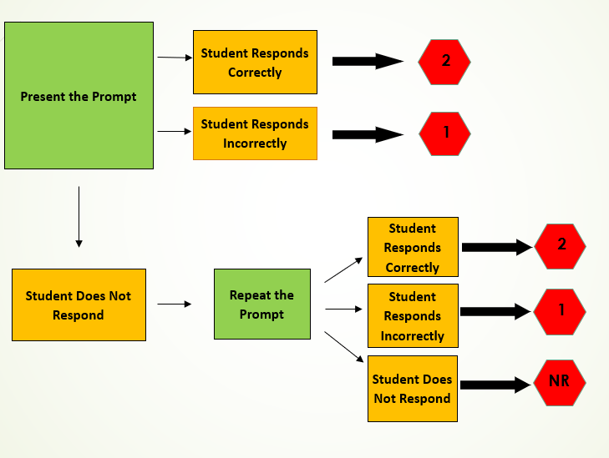
Supported Performance Task Scoring

Slide 45
Task Manipulatives
Prepare task manipulatives prior to testing

Slide 46
Supported Performance Task
Student Facing Page

Slide 47
Supported Performance Task
Teacher Facing Page
Notes:
I am now going to walk through the 5th grade Science Supported Performance task with you.
This is the teacher facing page. For supported performance tasks there are two teacher facing pages.
Read through the page to yourself before presenting the item to the student
The first portion of the task sets up the activity and tells the student what to do.
What the Test Examiner says is in bold font highlighted in gray.
Notice in the instructions the Test Examiner is to point to the picture and answer options as they read them.

Slide 48
Supported Performance Task
Student Facing Page

Slide 49
Supported Performance Task
Student Facing Page

Slide 50
Supported Performance Task
Student Facing Page

Slide 51
Supported Performance Task
Student Facing Page

Slide 52
Supported Performance Task
Student Facing Page

Slide 53
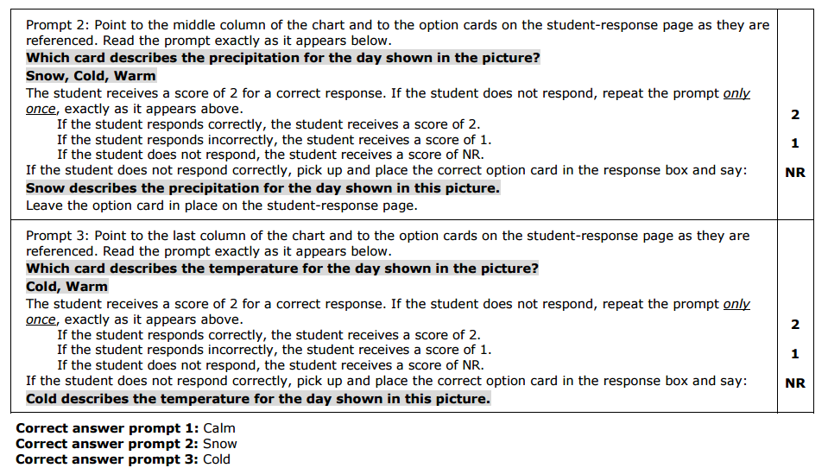
Supported Performance Task
Teacher Facing Page

Slide 54
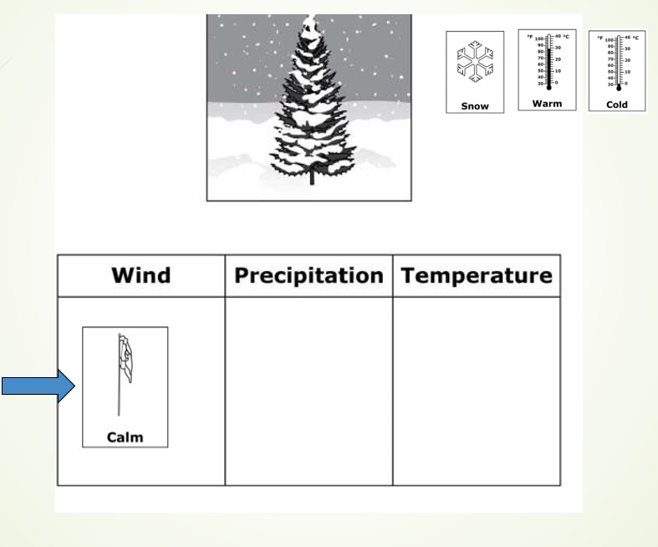
Supported Performance Task
Student Facing Page

Slide 55
Supported Performance Task
Student Facing Page

Slide 56
Supported Performance Task
Student Facing Page

Slide 57
Supported Performance Task
Student Facing Page

Slide 58
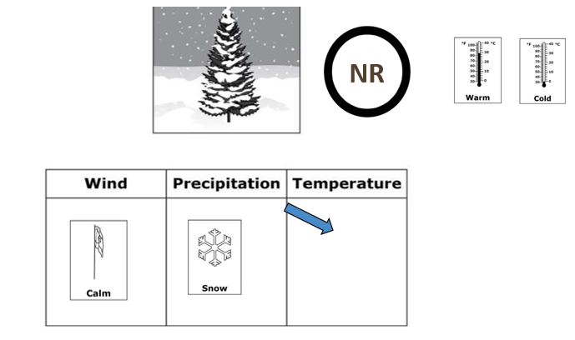
Supported Performance Task
Student Facing Page

Slide 59
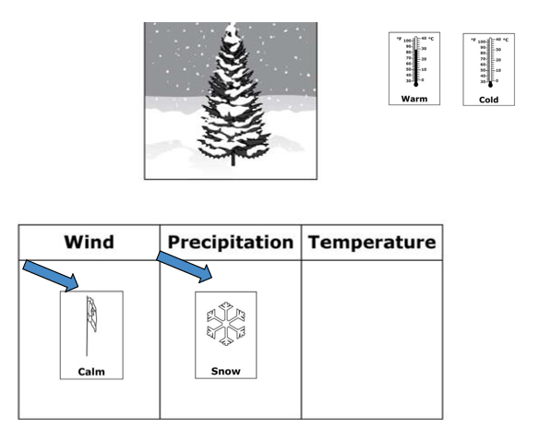
Supported Performance Task
Student Facing Page

Slide 60
Supported Performance Task
Teacher Facing Page

Slide 61
Supported Performance Task
Student Facing Page

Slide 62
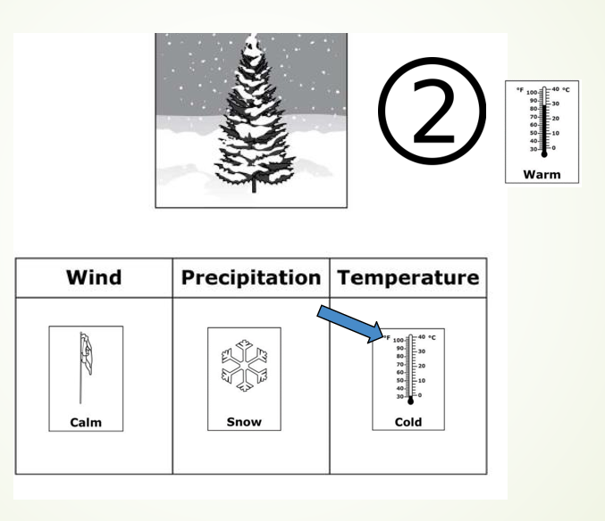
Supported Performance Task
Student Facing Page

Slide 63
Supported Performance Task
Student Facing Page

Slide 64
Supported Performance Task
Student Facing Page

Slide 65
Supported Performance Task
Student Facing Page

Slide 66
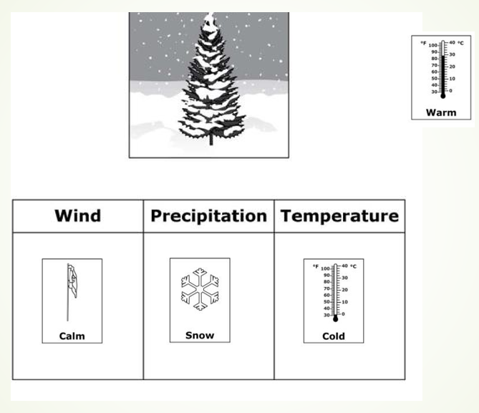
Supported Performance Task
Student Facing Page

Slide 67
Planning and scheduling for assessment administration days

Slide 68
Planning and Scheduling
Considerations
Number of students to be assessed
Administration time per testlet
Total administration time
Number of testing devices and assistive technologies needed
Assessment location
Consider unforeseen circumstances
Student absences
Test administrator absences
Longer than expected assessment sessions
School cancellations
Notes:
Consider the following when planning and scheduling test administration:
Determine the number of students to be assessed. Multiply that number by the number of testlets for the grades and content areas to be assessed. Most testlets take 5 to 15 minutes to administer, but that will vary from student to student since the population of students who participate in this assessment is so diverse. The average time to complete a testlet in Colorado is 7 minutes for math and 5 minutes for ELA. Using the released testlets as practice will provide some idea of how long each student will take to complete a testlet so plans may be made based on the total number of testlets being administered.
Consider the number of testing devices needed, the number of students who will complete testlets on a desktop or laptop computer versus a tablet, and the number of students who will need assistive technologies.
Determine where test administration will take place and whether students will be assessed in a classroom or if it is necessary to reserve space in a computer lab. Remember, the assessment cannot be administered to groups of students; even within the same grade, students will be taking different testlets at varying linkage levels with different TIPs. While this is a standardized assessment, it is individualized for students. It must be administered one-on-one.
Getting ready to administer an actual testlet requires a designated quiet area for testing clear from distractions. If it is necessary to assess a student in a classroom where other students are present, arrange the computer monitor or other testing display so it is only visible to the student being assessed. Also, set up any accessibility devices needed before initiating the testlet with the student.
Evaluate student behavior. Not every day is a good day to assess a student. Use professional judgment, and reschedule testing for another time if a student is not having a good day on the intended assessment day. If the student gets tired or distracted during a testlet sooner than expected, allow the student to take a short break. In some states, it is allowable to use the EXIT DOES NOT SAVE button to discontinue a testlet so a student can return to it and start over at a better time. Using the button erases all work on the current testlet. Therefore, the student will have to restart the testlet from the beginning. Follow state guidance regarding the use of the EXIT DOES NOT SAVE button.

Slide 69
Getting Ready
Designate testing location
Quiet area
Clear from distractions
Students are not to be tested in a room with other students.
Set up accessibility devices as needed
Stage materials as needed
Consult the TIP
Gather materials
Substitute as needed and allowed
Evaluate student behavior
Notes:
Getting ready to administer an actual testlet requires a designated quiet area for testing clear from distractions. If it is necessary to assess a student in a classroom where other students are present, arrange the computer monitor or other testing display so it is only visible to the student being assessed. Also, set up any accessibility devices needed before initiating the testlet with the student.
Evaluate student behavior. Not every day is a good day to assess a student. Use professional judgment, and reschedule testing for another time if a student is not having a good day on the intended assessment day. If the student gets tired or distracted during a testlet sooner than expected, allow the student to take a short break.
In Colorado, the Exit Do Not Save button should not be used for student behavior. Instead, it should only be used if the Test Administrator is called away and the student cannot return to finish testing. For example, a fire drill or another student has a medical issue that interrupts testing.

Slide 70
PearsonAccess^{next} Navigation Training

Slide 71
Login to PearsonAccessnext.com

Slide 72
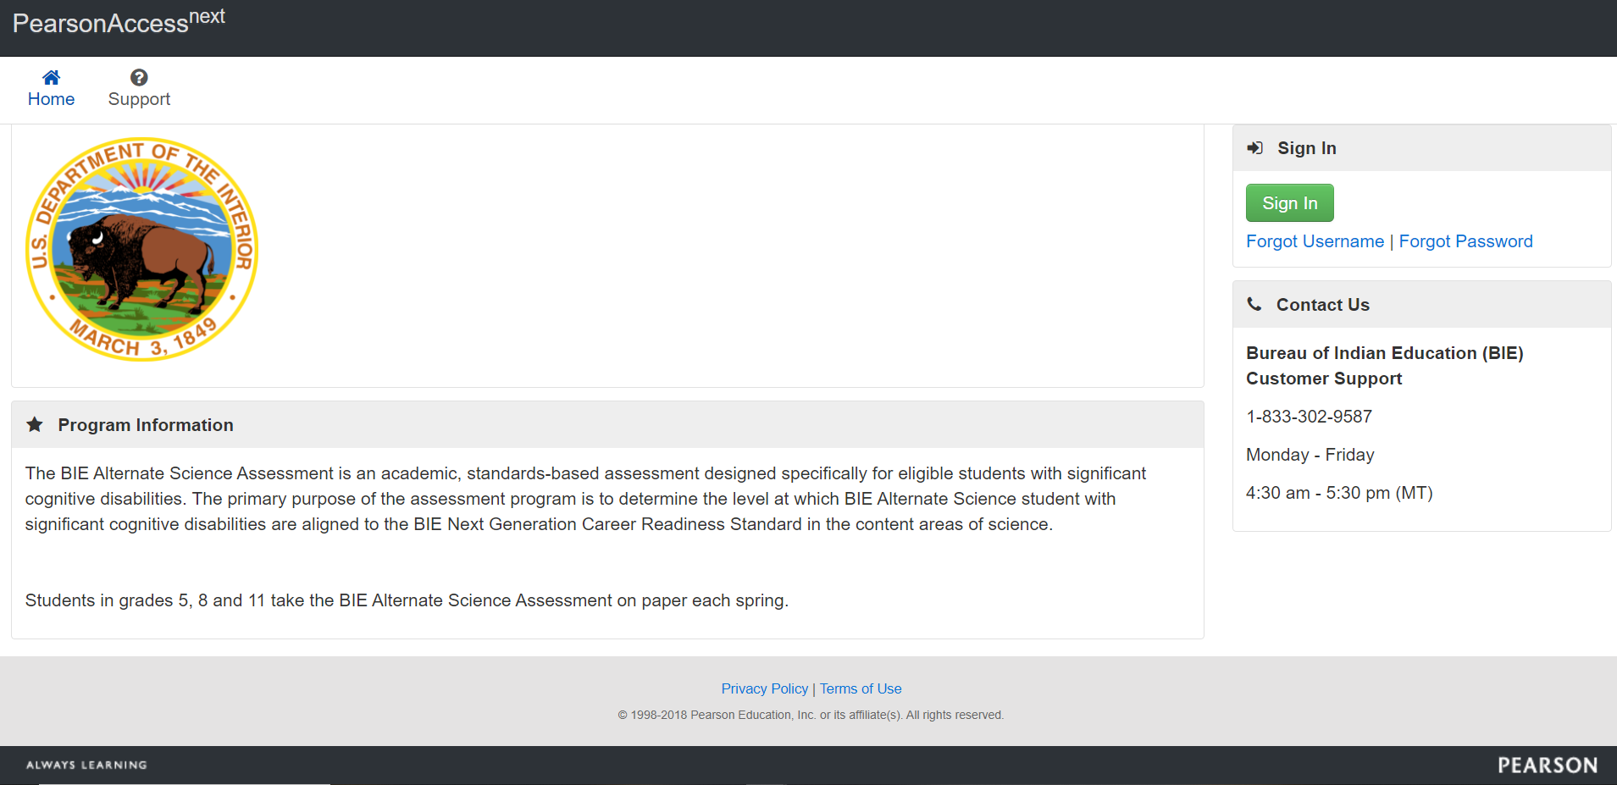
Sign In

Slide 73
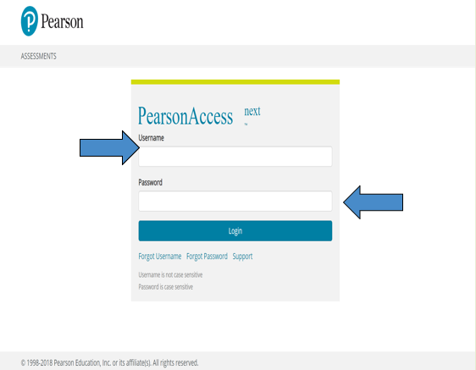
Login with your Username and Password
You should have received an e-mail from PearsonAccess Next containing your username and a link to reset your password.
For future reference, you are now able to reset the password yourself by returning to the PearsonAccess Next sign in screen, then below the password box, please click the link called Forgot Password.

Slide 74
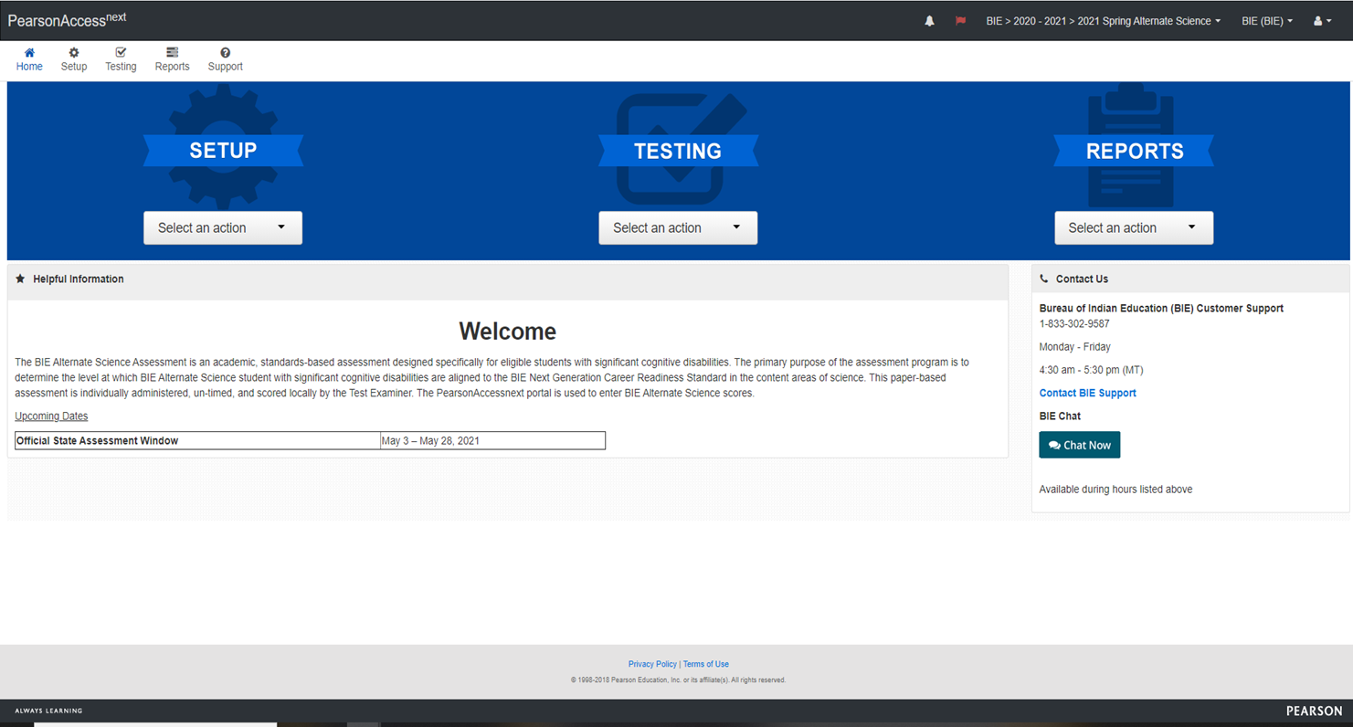
BIE Alternate Science PearsonAccess^{next} Site

Slide 75
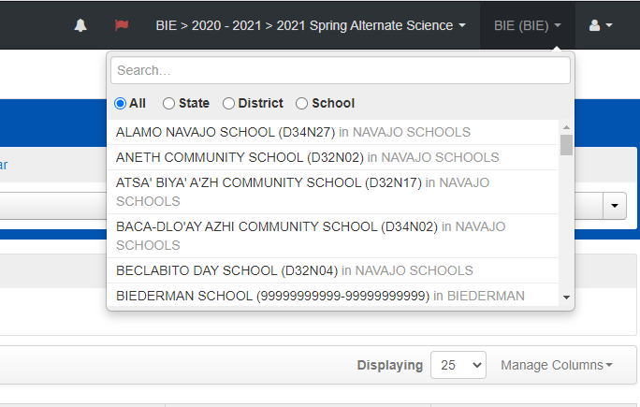
Locate your School in PearsonAccess^{next}

Slide 76
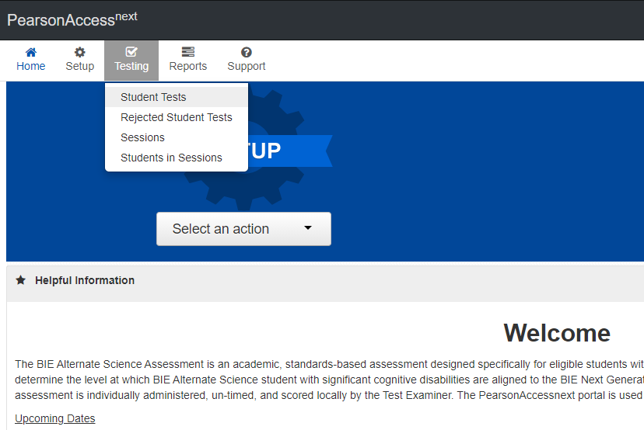
Finding Students in PearsonAccess^{next}

Slide 77
Finding Students in PearsonAccess^{next}

Slide 78
Finding Students in PearsonAccess^{next}

Slide 79
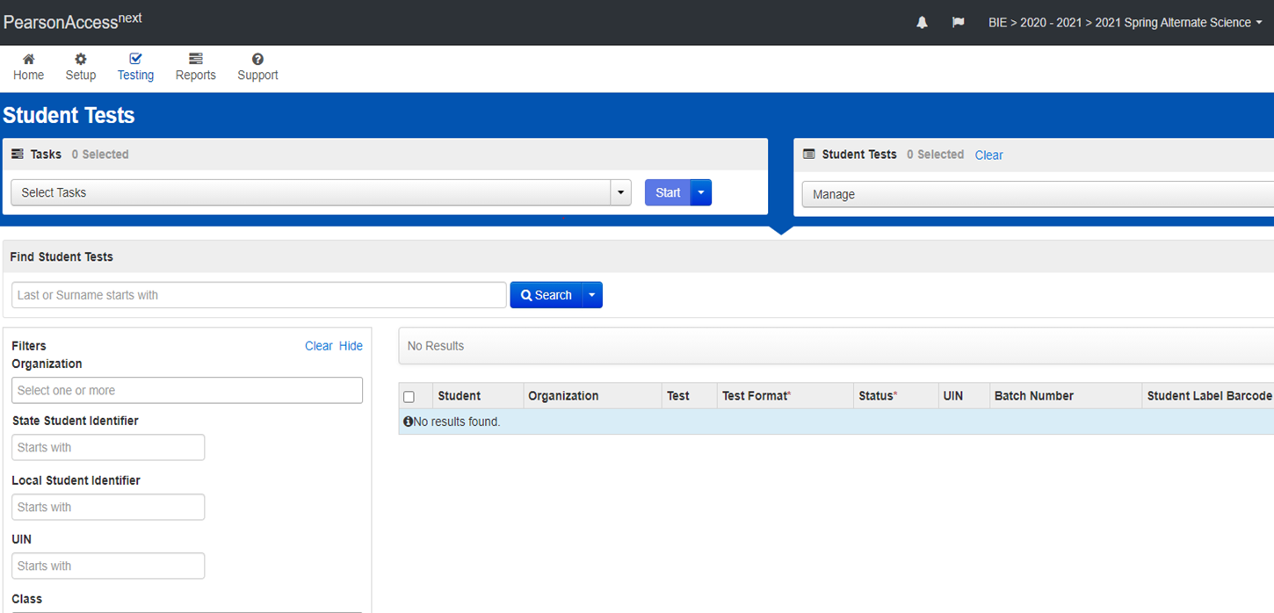
If no Students are in PearsonAccess^{next}
Students were not uploaded. Contact your School Test Coordinator
Students are in another school and need to be transferred. Call Customer Service so we can do a Work Request for those students.

Slide 80
Scoring

Slide 81
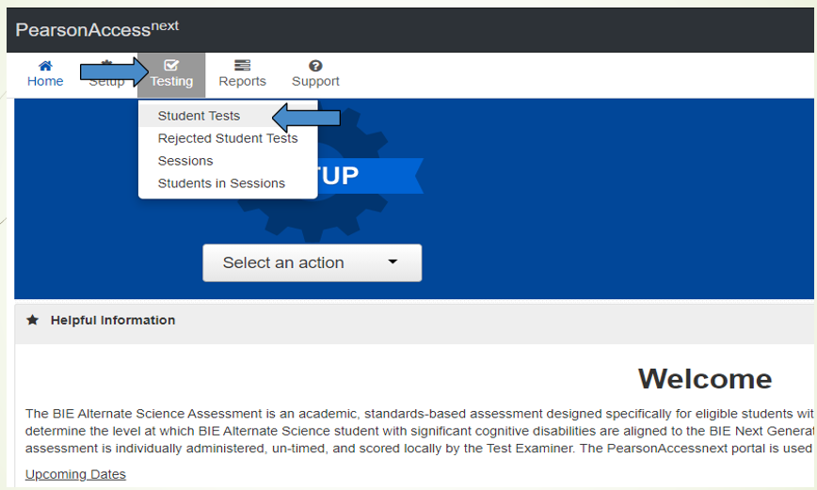
Scoring
Please make sure to be in the correct school

Slide 82
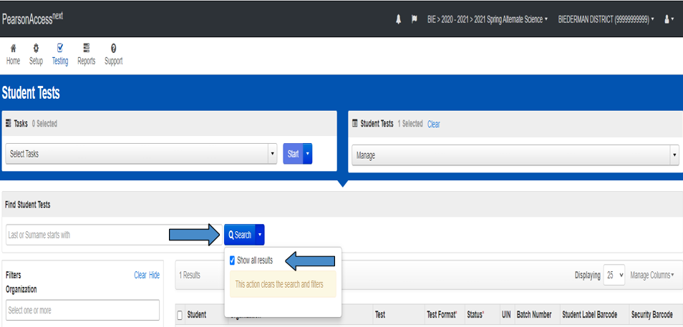
Scoring

Slide 83
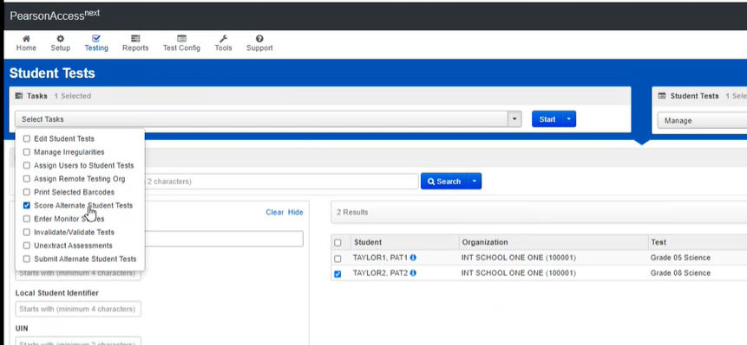
Scoring
2nd
3rd
1st

Slide 84
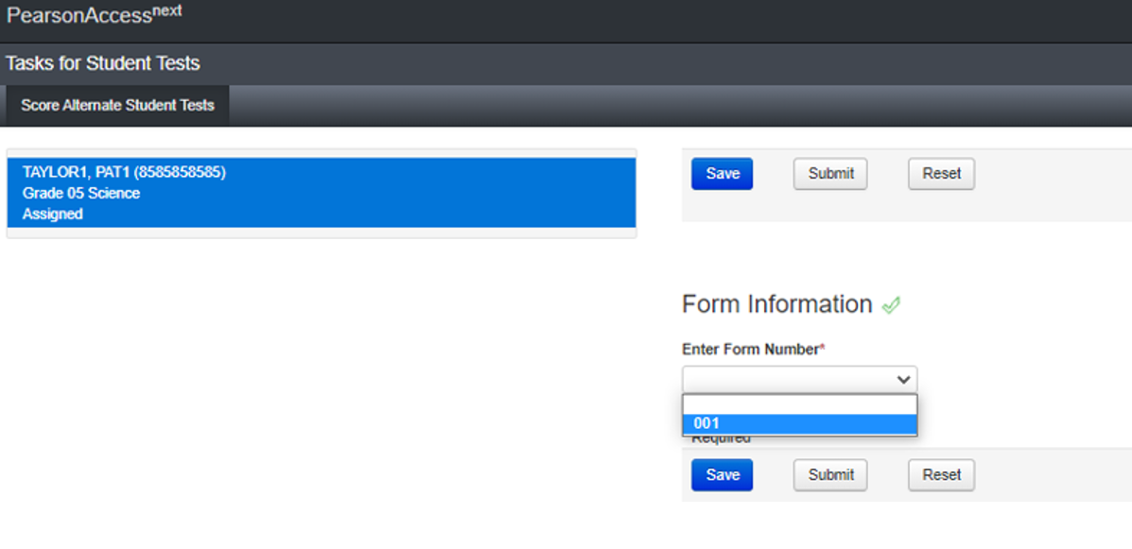
Scoring

Slide 85
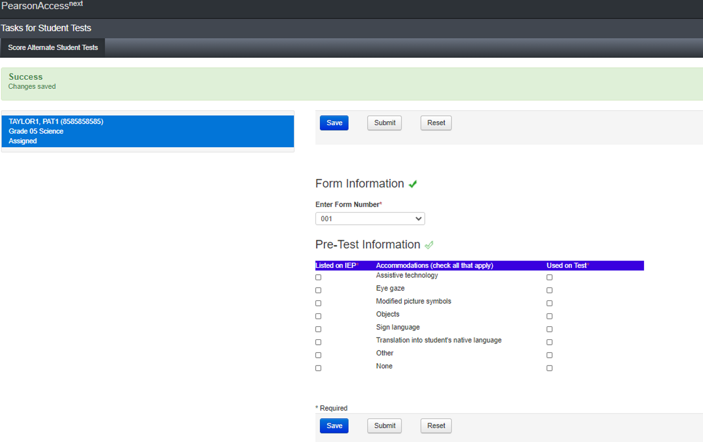
Scoring

Slide 86
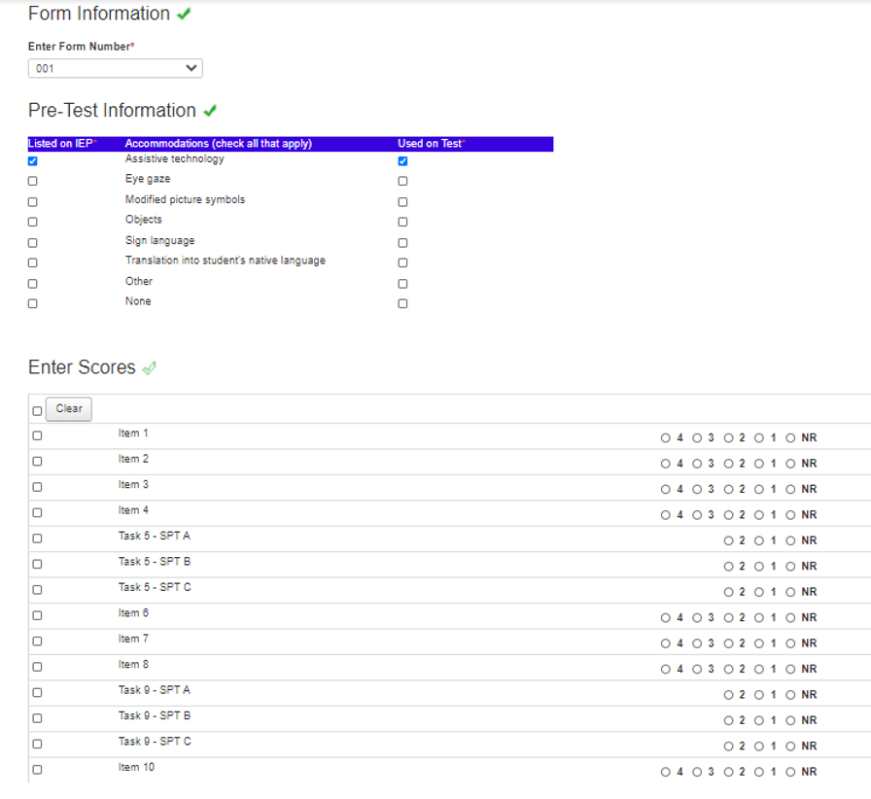
Scoring

Slide 87
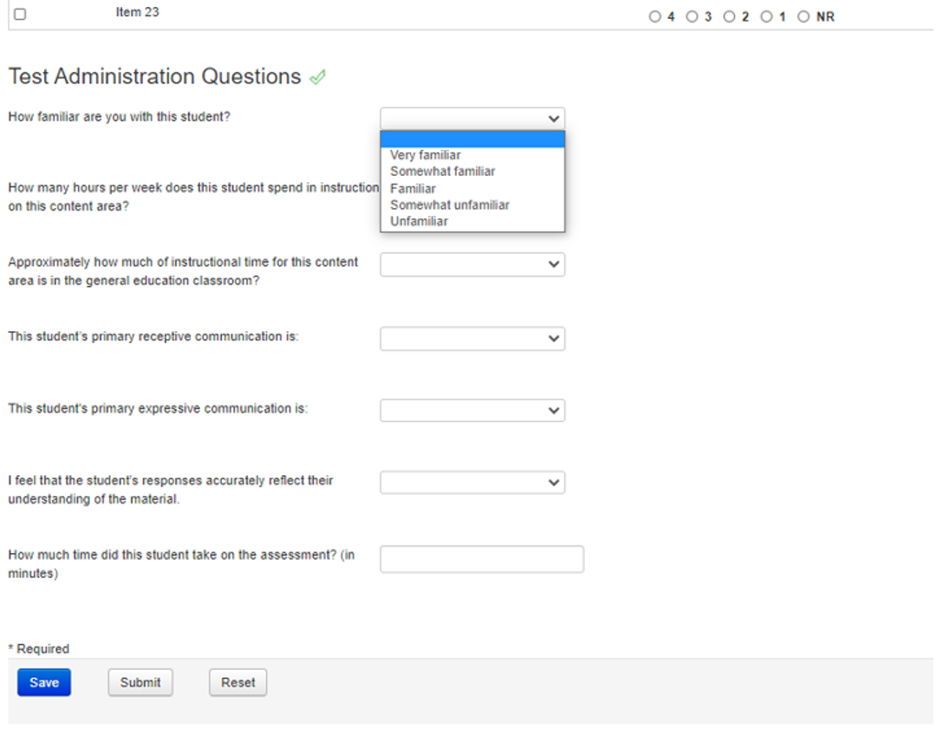
Scoring
Optional to fill out

Slide 88
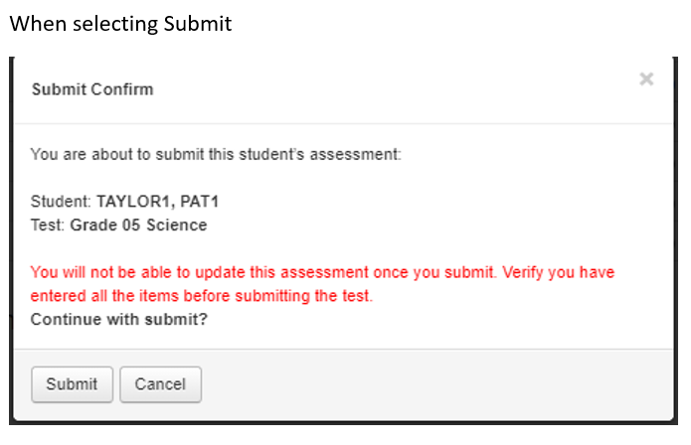
Scoring

Slide 89
Wrap-Up

Slide 90
Notes
All parts of Science are read to the student
Answer options can be accommodated for the student’s needs
Must remain in the same order
Cannot rephrase or use other words to describe them
Personal lexicon is allowed on Science
Paraprofessionals cannot give any portion of the assessment
May be in the room as support
BIE Alternate Science Monitoring
Used for training purposes

Slide 91
Pearson Resources

Slide 92
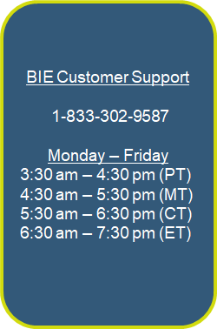
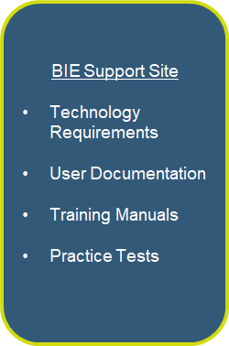
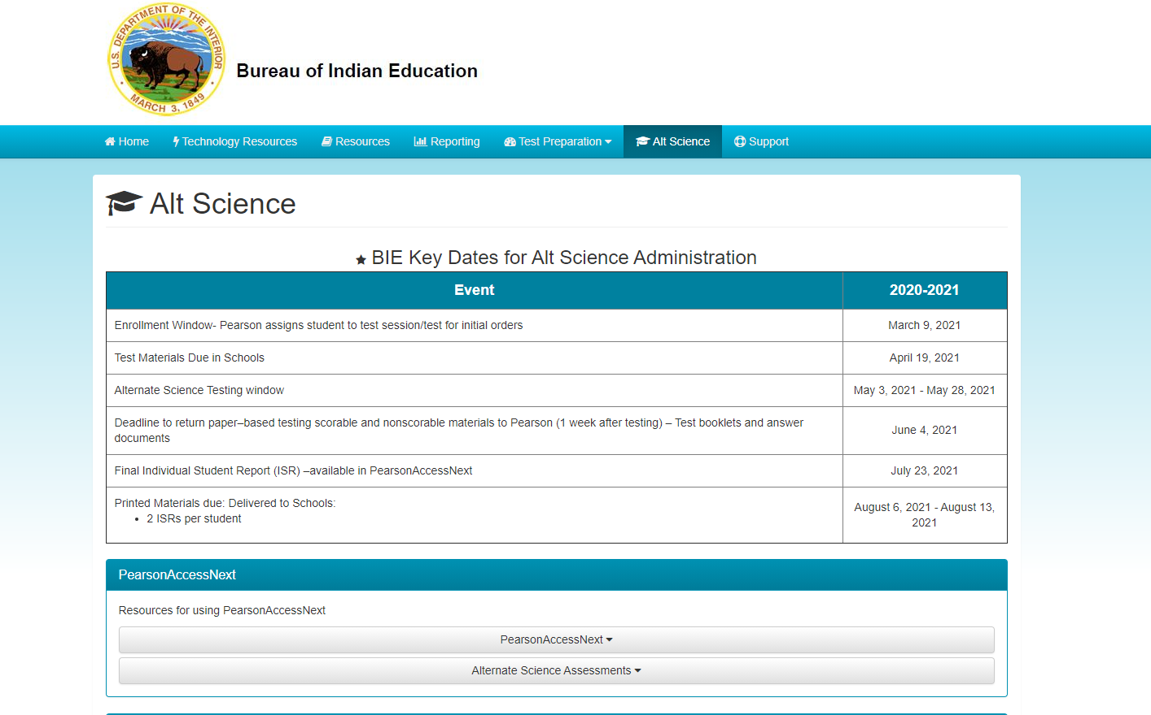
Pearson Resources
bie.mypearsonsupport.com/altScience/

Slide 93
BIE Contacts
For General Questions related to the Alternate Science Assessment:
Aurelia Shorty, Education Specialist in ADD Navajo, Aurelia.Shorty@bie.edu
Dr. Maureen Lesky, Program Analyst, Maureen.Lesky@bie.edu
For questions related to Assessment data files:
Dr. Rebecca Izzo, Research Analyst, Rebecca.Izzo@bie.edu
For questions related to the Assessment contract:
Niccole White, Contracting Officer’s Representative, Niccole.White@bie.edu
For questions related to Special Education Programs, contact your local Special Education Coordinator

Slide 94
Participation
Remote Status due to Tribal Resolution during Testing Window:
The Chief Academic Office has been consistently been telling schools to prepare and plan for administering the assessments this Spring. The tests are not designed to be given at home for test security reasons. The tests must be administered in person at the school site. The testing windows have been extended so there is a greater chance for schools to participate in testing this Spring.
If your local Tribe has a resolution or prohibition to NOT be in school such as a "shelter in place," or "stay at home order," during the testing window, then schools should follow the local Tribal decisions. Those Tribal resolutions should be sent to folks in the school's chain of command - Education Program Administers (EPAs), Associate Deputy Directors (ADDs), the Chief Academic Officer - Dr. Tamarah Pfeiffer, tamarah.pfeiffer@bie.edu, and the Central Office, Kylie.Morden@bie.edu. BIE will track those schools with Tribal resolutions stating the community and school are in a "stay at home" order during the testing window.

Slide 95
Thank You

